Slide 1
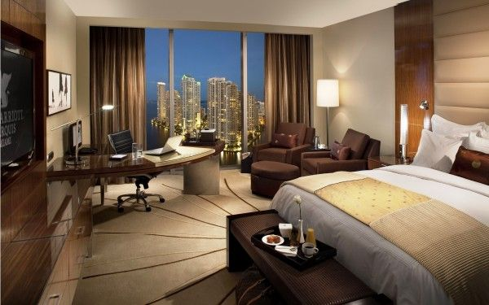

HOTEL AGGREGATOR ANALYSIS
Presented by
Kanimozhi
Presented by
Kanimozhi

Slide 2
INTRODUCTION
This Project aims to analyse a dataset of hotel aggregator listings using Power BI.
The dataset comprises various attributes related to listings, hosts, reviews, and availability.
The objective is to create comprehensive visualizations and insights that shed light on trends, patterns, and factors influencing the performance of listings.
It will explore key metrics such as pricing, availability, host characteristics, and review scores to derive actionable insights for improving the overall quality and competitiveness of the listings.

Slide 3
DATASET DESCRIPTION
1. id: Unique identifier for each listing.
2. listing_url: URL of the listing on the hotel aggregator platform.
3. scrape_id: Identifier for the data scraping event.
4. last_scraped: Date of the last data scrape.
5. source: Source of the listing information.
6. name: Name of the listing.
7. description: Description of the listing.
8. Neighborhood_overview: Overview of the neighborhood where
the listing is located.
9. Picture_url: URL of the listing's picture.
10. host_id: Unique identifier for the host.
11. ... (and many more columns capturing details about hosts,
location, property type, room details,
amenities, pricing, availability, reviews, and other relevant information)

Slide 4
PROJECT OBJECTIVES
1. Geographical Insights:
Visualize the distribution of listings on a map to identify popular neighborhoods.
Explore the geographical concentration of listings and host locations.
2. Pricing and Availability Analysis:
- Analyze pricing trends based on property types, room types, and accommodation capacity.
- Investigate the availability of listings over time and identify peak periods.
3. Host Performance:
- Evaluate host characteristics, including superhost status, response times, and verification methods.
- Explore correlations between host attributes and listing performance.
4. Review Scores and Guest Satisfaction:
- Examine review scores and their impact on overall listing performance.
- Identify areas for improvement based on specific review categories.
5. Property Type and Room Analysis:
- Analyse the distribution of property types and room types.
- Explore trends in the popularity of specific accommodation setups.

Slide 5
RECOMMENDATIONS
The annual availability is experiencing a significant decline, underscoring the critical need to focus efforts on enhancing yearly availability levels.
Enhancing the review score entails adjusting pricing to ensure affordability for all guests and prioritizing swift responses to inquiries and feedback.
Shared room types offer more affordability compared to entire or private accommodations. There is a pressing need to enhance pricing across all room categories to ensure competitiveness and appeal to a broader range of guests.
Continuously monitor guest satisfaction levels over time to pinpoint areas requiring improvement.

Slide 6
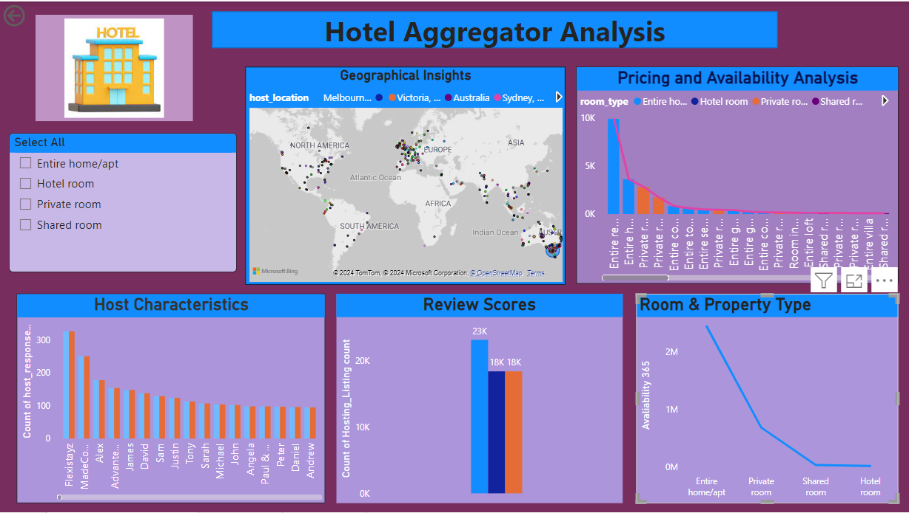

Slide 7
CONCLUSION
THANK YOU

